Slide 1



Employee Salary Calculator Application
By: Wen Ching, Lee

Slide 2
INTRODUCTION
An simple Java program GUI to calculate net salary of Employees to reduce laborious task in a company.
Calculate the EPF, SOSCO, EIS and Net Salary
User friendly for everyone even have no experience in programming.

Slide 3
PROBLEM BACKGROUND
Due to COVID-19, Malaysia Government offer employee to choose for their EPF contribution, which is 9% and 11%.
This causing extra workload to the payroll team to calculate employee salary.
This application will help to simplified the calculation task.

Slide 4
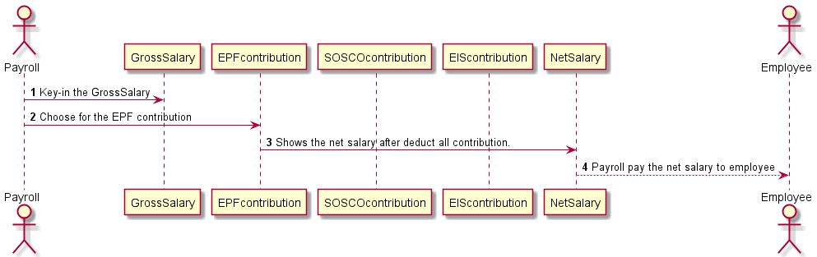
PROJECT IMPLEMENTATION
Simple UML Sequence Diagrams and Flow Charts with PlantUML

Slide 5
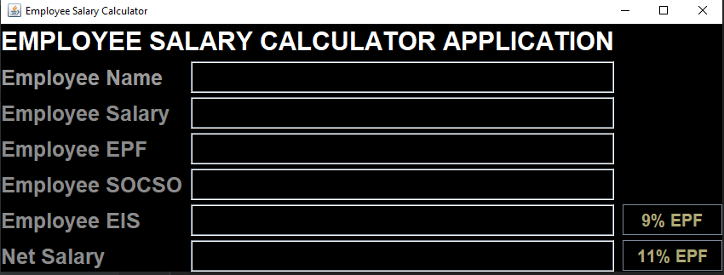
PRODUCT DEPLOYMENT
After we have run the code, this simple GUI interface will appear

Slide 6
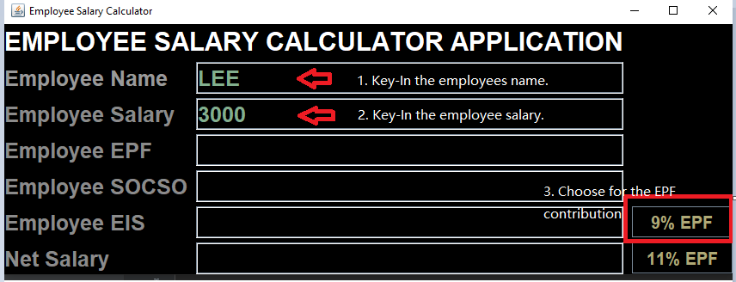
PRODUCT DEPLOYMENT
In order to run the application, we need to key in the employees name and salary. After that choose the right EPF contribution.

Slide 7
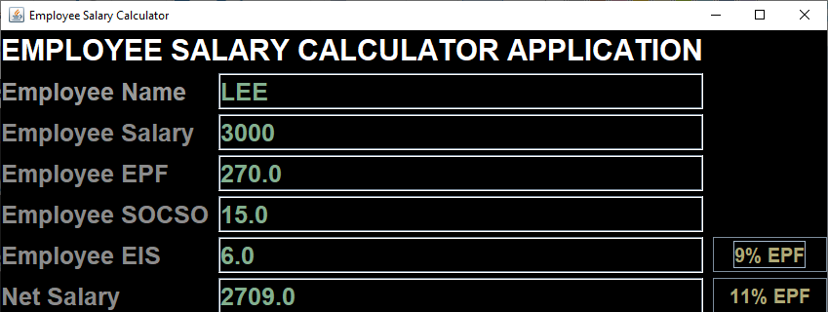
PRODUCT DEPLOYMENT
The application will automatically calculate the EPF, SOCSO, EIS contribution and Net salary.

Slide 8
CONCLUSION
In this project, it include of JFrame, JLabel, JButton and JTextField is used to create the GUI interface. Other than that, the actionListener and actionPerformed is used to let the user to choose for the EPF contribution %. This Employee Salary Calculator application will be more efficient when it linked to the company SQL data base.

Slide 9
GITHUB LINK
https://github.com/wlexiiii/Employee-Salary-Aplication.git

Slide 10
THANK YOU!

